Slide 1
Objective: Fossil Fuels
Formation
Extraction
Human Impact

Slide 2
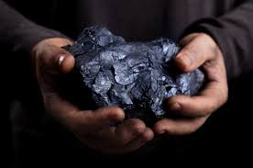
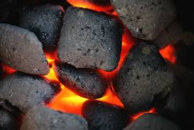
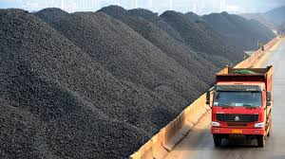
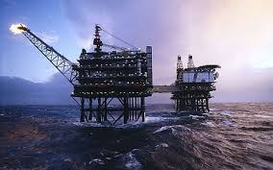
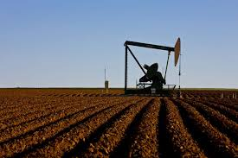
Coal & Gas Products How are they formed?
How are they extracted?
Underground mining
Strip mining
Drilling
Cap removal
Fracking

Slide 3
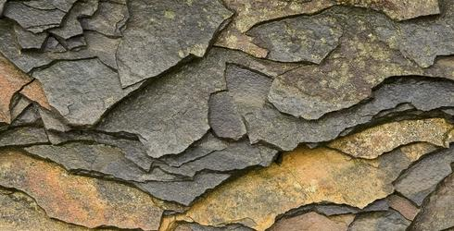
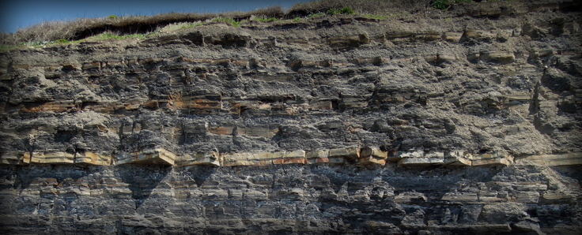
FRACKING
WHAT? Shale
What do you see? Layers
Why important? They hold natural gas

Slide 4
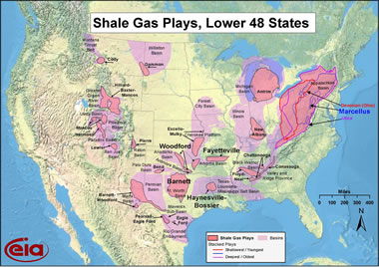
Where?
Throughout the U.S. where there are coal and oil fields

Slide 5
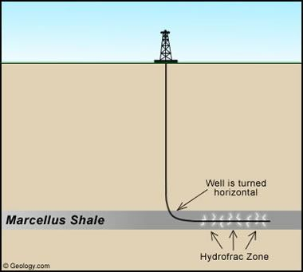
How?
Drill down to the shale
Drill horizontally through the shale
Pump water, chemicals, & sand mixture to break up the shale
Capture the released gas

Slide 6
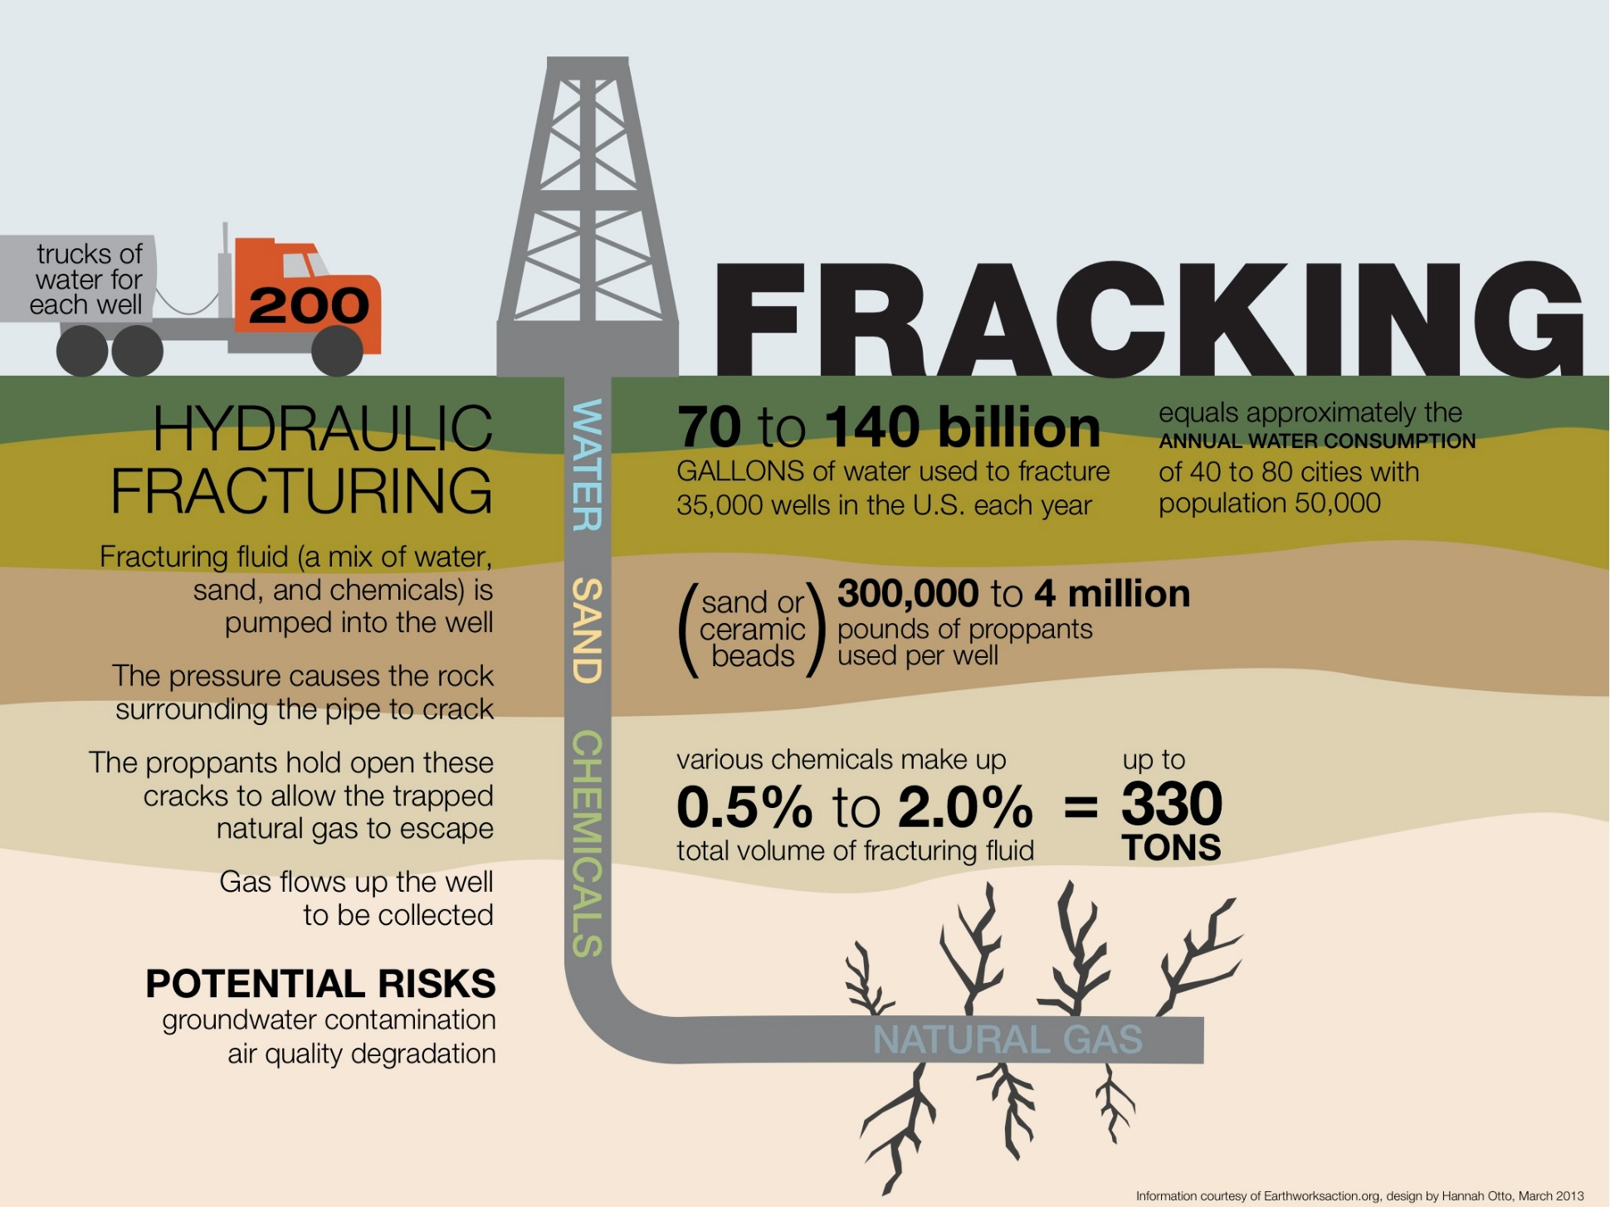
Impact?
Water mixture is left behind = pollute local drinking water
Fracturing is linked to an increase in earthquakes
Using potable water for the process
Collected water mixture is stored in “water fills” = pollute local drinking water
Air pollution

Slide 7
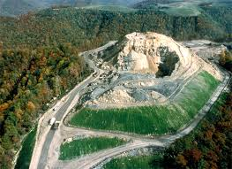
Resource Management: The sustainability of societies and biodiversity is dependent upon the responsible management of natural resources.
Conservation -- use less, conserve habitat
Develop and test new technologies (capture and storage of waste, obtaining resource, cleaner ways to use the resource)
Change how resources are extracted (strip mining, cap removal, fracking, mining, drilling, etc.)

Slide 8
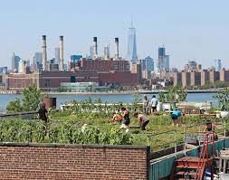
Resource Management: The sustainability of societies and biodiversity is dependent upon the responsible management of natural resources.
Reduce habitat destruction
Increase urban sustainability—the only way we can exist is by using fossil fuels
Increase agricultural efficiency – rooftop farming, get more calories per acre

Slide 9
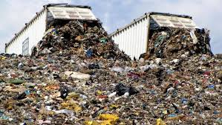
Resource Management: The sustainability of societies and biodiversity is dependent upon the responsible management of natural resources.
Understanding the relationship between personal behavior/choices and global economics (cost of gas has gone down because of an increase in supply)

