Slide 1
The Structure & Composition of The Earth

Slide 2
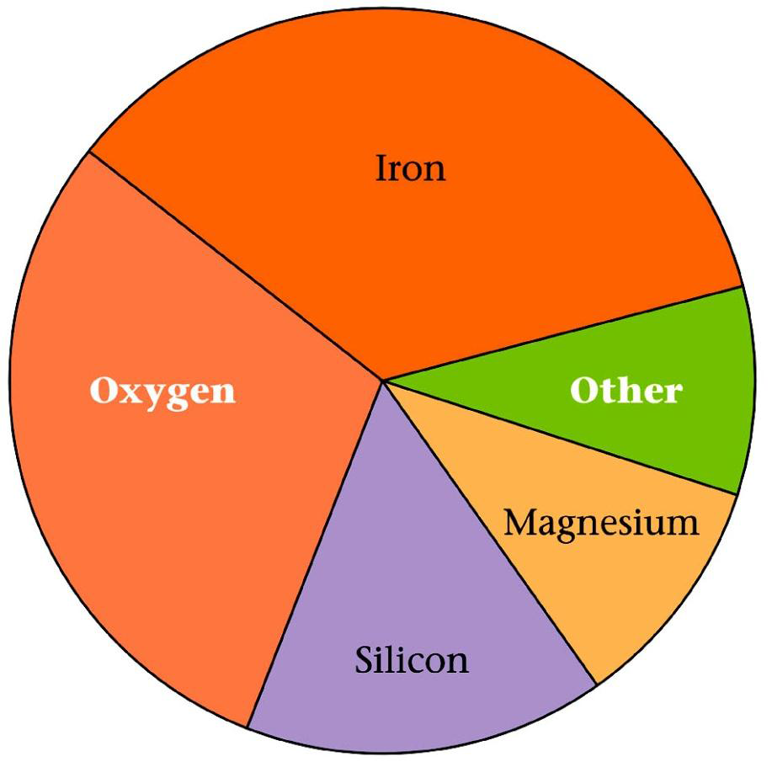
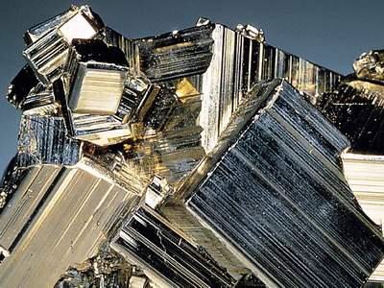
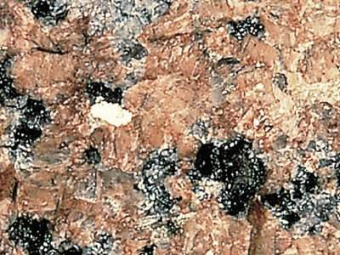
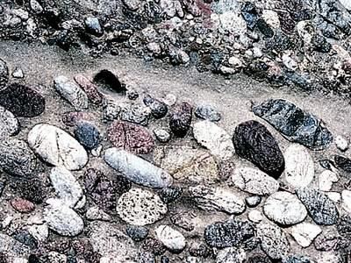
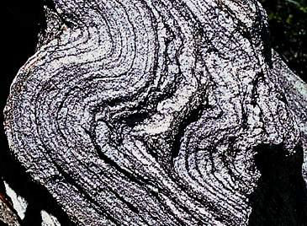
Earth’s Components
O Earth’s elemental composition reflects mostly heavier elements not blown away by solar wind during formation of the solar system
O Most abundant elements
O Fe, O, Si, Mg
O Most common minerals consist of silica (SiO2) mixed in varying proportions with other elements such as Fe, Mg, Al, Ca, K, Na
O Felsic = more silica (less Fe/Mg) & less dense
O E.g. Granite
O Mafic = less silica (more Fe/Mg)
& more dense
O E.g. Gabbro / Basalt
O Range: Felsic / Intermediate / Mafic / Ultramafic
35%
10%
30%
10%
15%
Bulk Earth composition

Slide 3
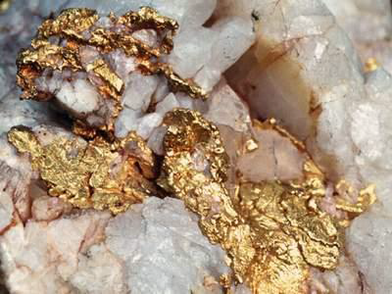
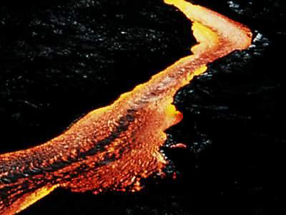
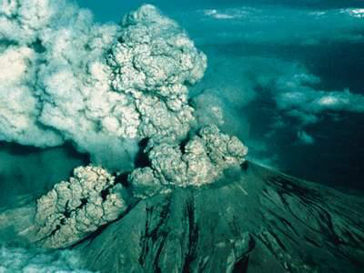
Earth Materials
•Metals – Solids made of metallic elements.
•Melts – Rocks that have been heated to a liquid.
–Magma – Molten rock beneath the surface.
–Lava – Molten rock at the surface.
•Volatiles – Materials that turn into gas at surface temps.
–H2O, CO2, CH4, and SO2
–Volatiles are released from volcanic eruption

Slide 4
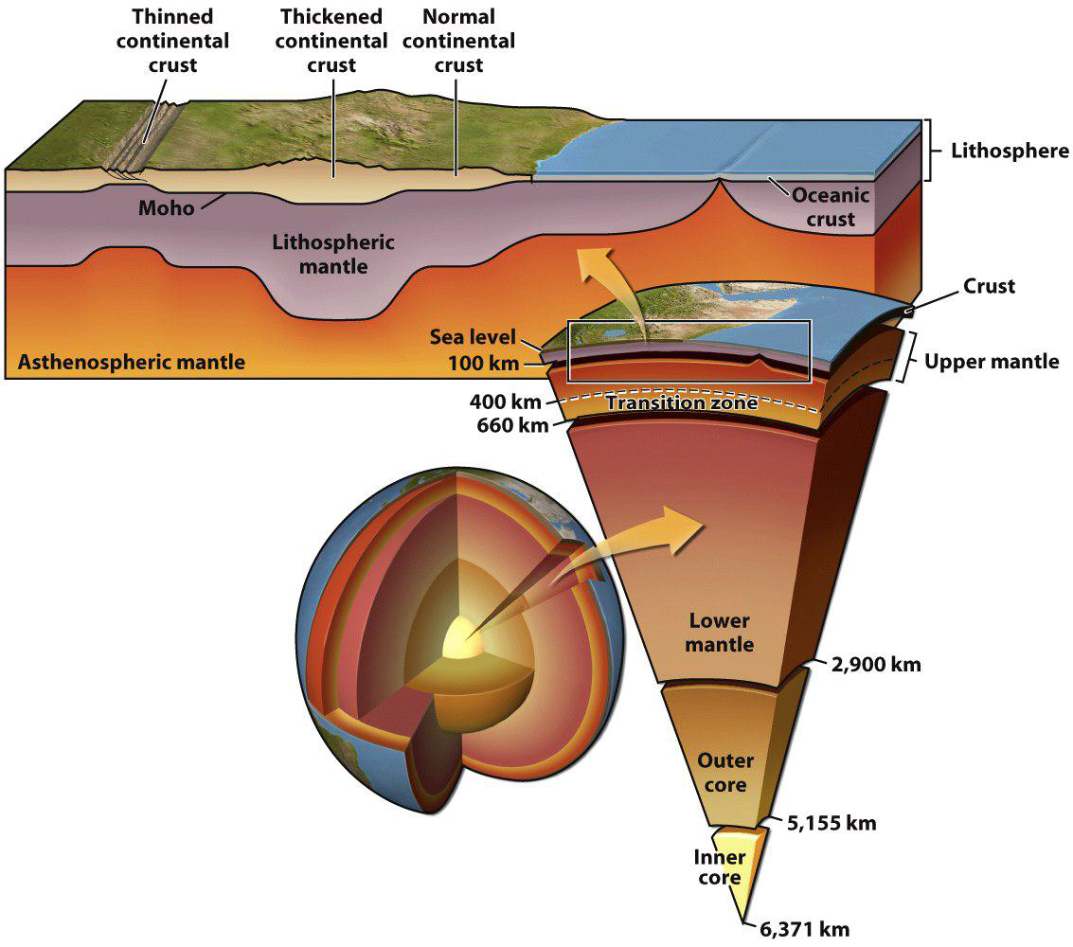
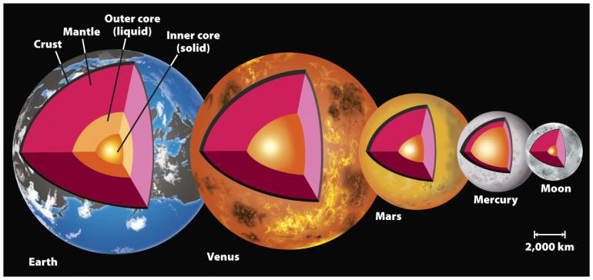
Earth’s Layers: Based on Composition
–Crust
•Continental
•Oceanic
–Mantle
•Upper
•Lower
–Core
•Outer – Liquid
•Inner – Solid

Slide 5
The Crust
•The outermost “skin” of Earth with variable thickness.
–Thickest under mountain ranges (70 km – 40 miles).
–Thinnest under mid-ocean ridges (3 km – 2 miles).
•The Mohorovičić discontinuity or “Moho” is the lower boundary.
–Separates the crust from the upper mantle.
–Discovered in 1909 by Andrija Mohorovicic.
–Marked by a change in the velocity of seismic P waves.

Slide 6
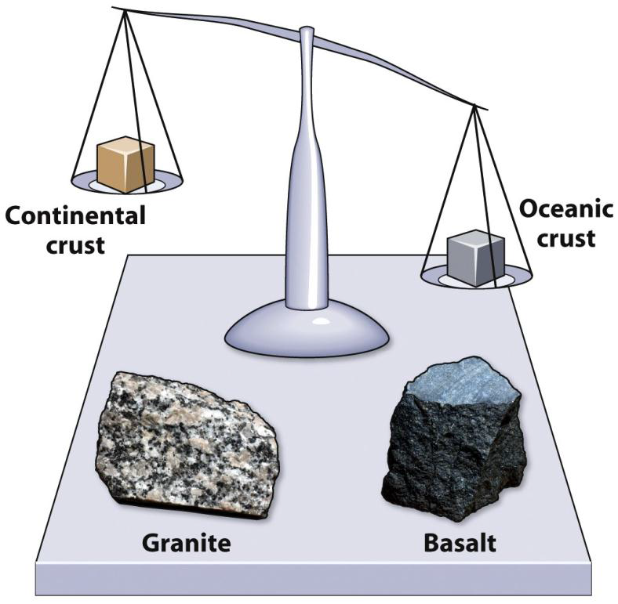
Two Types of Crust
•Continental crust – Underlies the continents.
–Avg. rock density about 2.7 g/cm³.
–Avg. thickness 35-40 km.
–Felsic composition. Avg. rock type = Granite
•Oceanic crust – Underlies the ocean basins.
–Density about 3.0 g/cm³.
–Avg. thickness 7-10 km.
–Mafic composition
Avg. rock type = Basalt/Gabbro

Slide 7
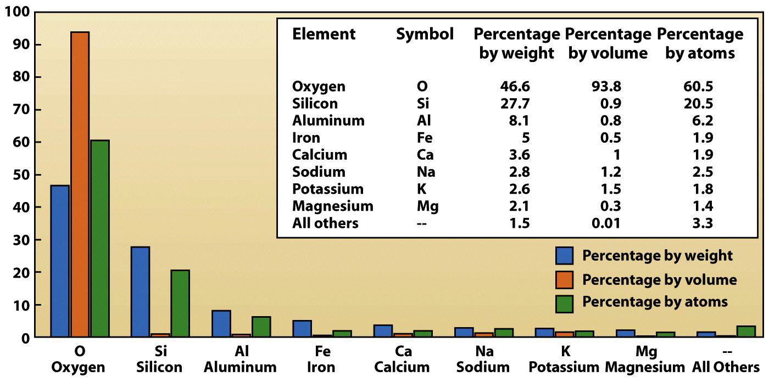
Crustal Composition
•98.5% of the crust is comprised of just 8 elements.
•Oxygen is (by far!) the most abundant element in the crust.
–This reflects the importance of silicate (SiO₂-based) minerals.
–As a large atom, oxygen occupies ~93% of crustal volume.

Slide 8
Earth’s Mantle
•Viscoelastic Solid layer between the crust and the core
•2,885 km thick & 65% of Earth’s mass
•Mantle composition = Si, O, Fe, Mg
•Below ~100-150 km, the rock is hot enough to flow.
•It convects: hot mantle rises, cold mantle sinks.

Slide 9
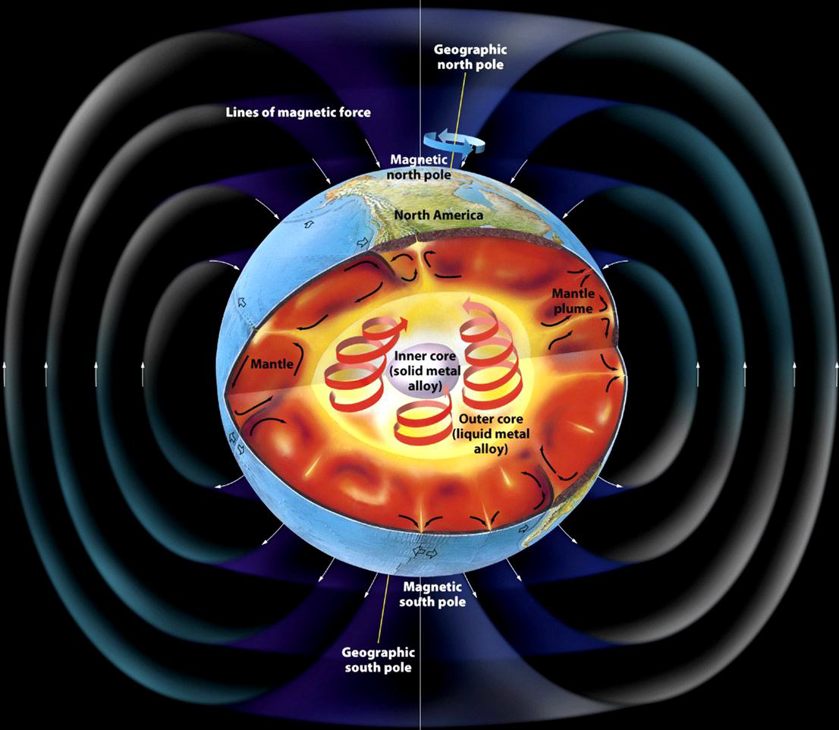
The Core (33% of Earth’s Mass)
•An iron-rich sphere with a radius of 3,471 km.
•2 components with differing seismic wave behavior.
•Flow in the outer core generates the magnetic field—causes Aurora Borealis (click to see video)
–Outer core
•Liquid iron-nickel-sulfur
Flow generates convection
currents = Earth’s magnetic
field
•2,255 km thick
•Density – 10-12 g/cm3
–Inner core
•Solid iron-nickel alloy due to
Immense pressure
•Radius of 1,220 km.
•Density – 13 g/cm3

Slide 10
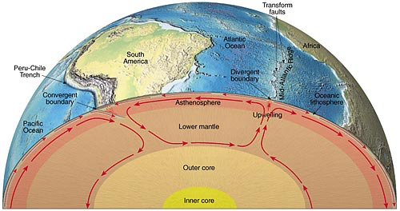
Earth’s Layers Based on Mechanical Properties
•Lithosphere – brittle, non-flowing, rigid material (tectonic plates)
–2 components: crust and upper mantle.
•Asthenosphere – The ductile solid – “lubricant” for plates to slide over
–Shallower under oceanic lithosphere
–Deeper under continental lithosphere
–Site of Convection Currents
--Why is Earth so hot?
(CLICK on EARTH)

Slide 11
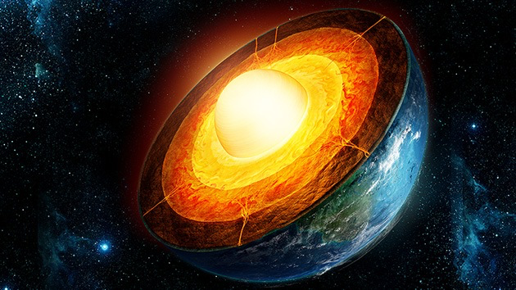
Why is Earth so Hot?
Gravitational contraction—Gravity causes Earth’s center to squeeze together=pressure=release of heat
Residual heat from Earth’s formation
Frictional heating from convection currents (rocks rub during convection)
Radioactive decay = 50% of Earth’s internal heat

Slide 12
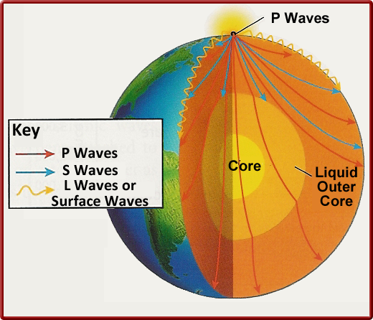
Evidence of Earth’s Composition
Reason #1 = Seismic Waves—Earthquakes cause energy waves—P waves go through core BUT S waves can’t pass through liquid outer core

Slide 13
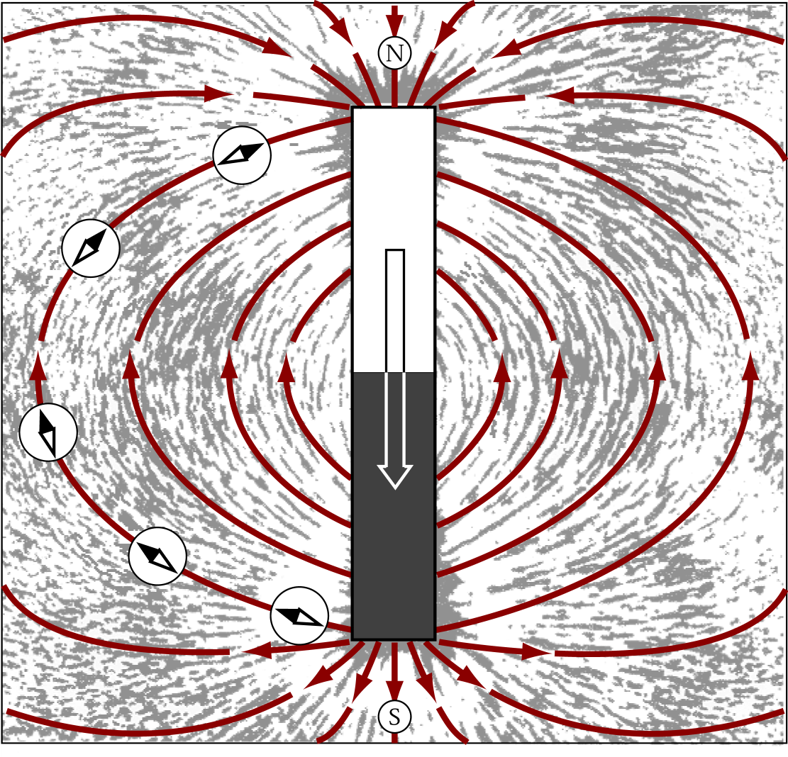
Reason #2: Earth’s Magnetic Field
Geodynamo
-The Earth’s magnetic field is produced by the geodynamo
-Flow in the liquid iron outer core creates a magnetic field
Magnetic field
- region affected by force emanating from a magnet - grows stronger as separating distance decreases - attracts or repels magnetically charged or moving electrically charged objects - compasses work because Earth is a large magnet

